Slide 1

Learning Objective
I will be able to sketch quadratic equations using transformations.
Enter quietly, please be ready with the following on your desk:
Whiteboard
Whiteboard marker
Exercise Book
Pencil, pen, ruler and red pen
Diary
Calculator
Device – charged or borrowed from Library before maths

Slide 2




Daily Review
CFU 1
What did we do to find the value of y when x = -3?
Sketch the graph of the following equation $y = x2+3$for $−3≤x≤2$
Substitute each number into the equation to find the points we need.
CFU 2
What did we do to find the value of y when x = -2?
$$y = x2+2x+3$$
$$y =\left(−1\right)2+3$$
$=1+3$
$=4$
$$y = x2+3$$
$$y =\left(−2\right)2+3$$
$=4+3$
$=7$
$$y = x2+3$$
$$y =\left(−3\right)2+3$$
$=9+3$
$=12$
x | -3 | -2 | -1 | 0 | 1 | 2
y | 12 | 7 | 4 | 3 | 4 | 7

Slide 3
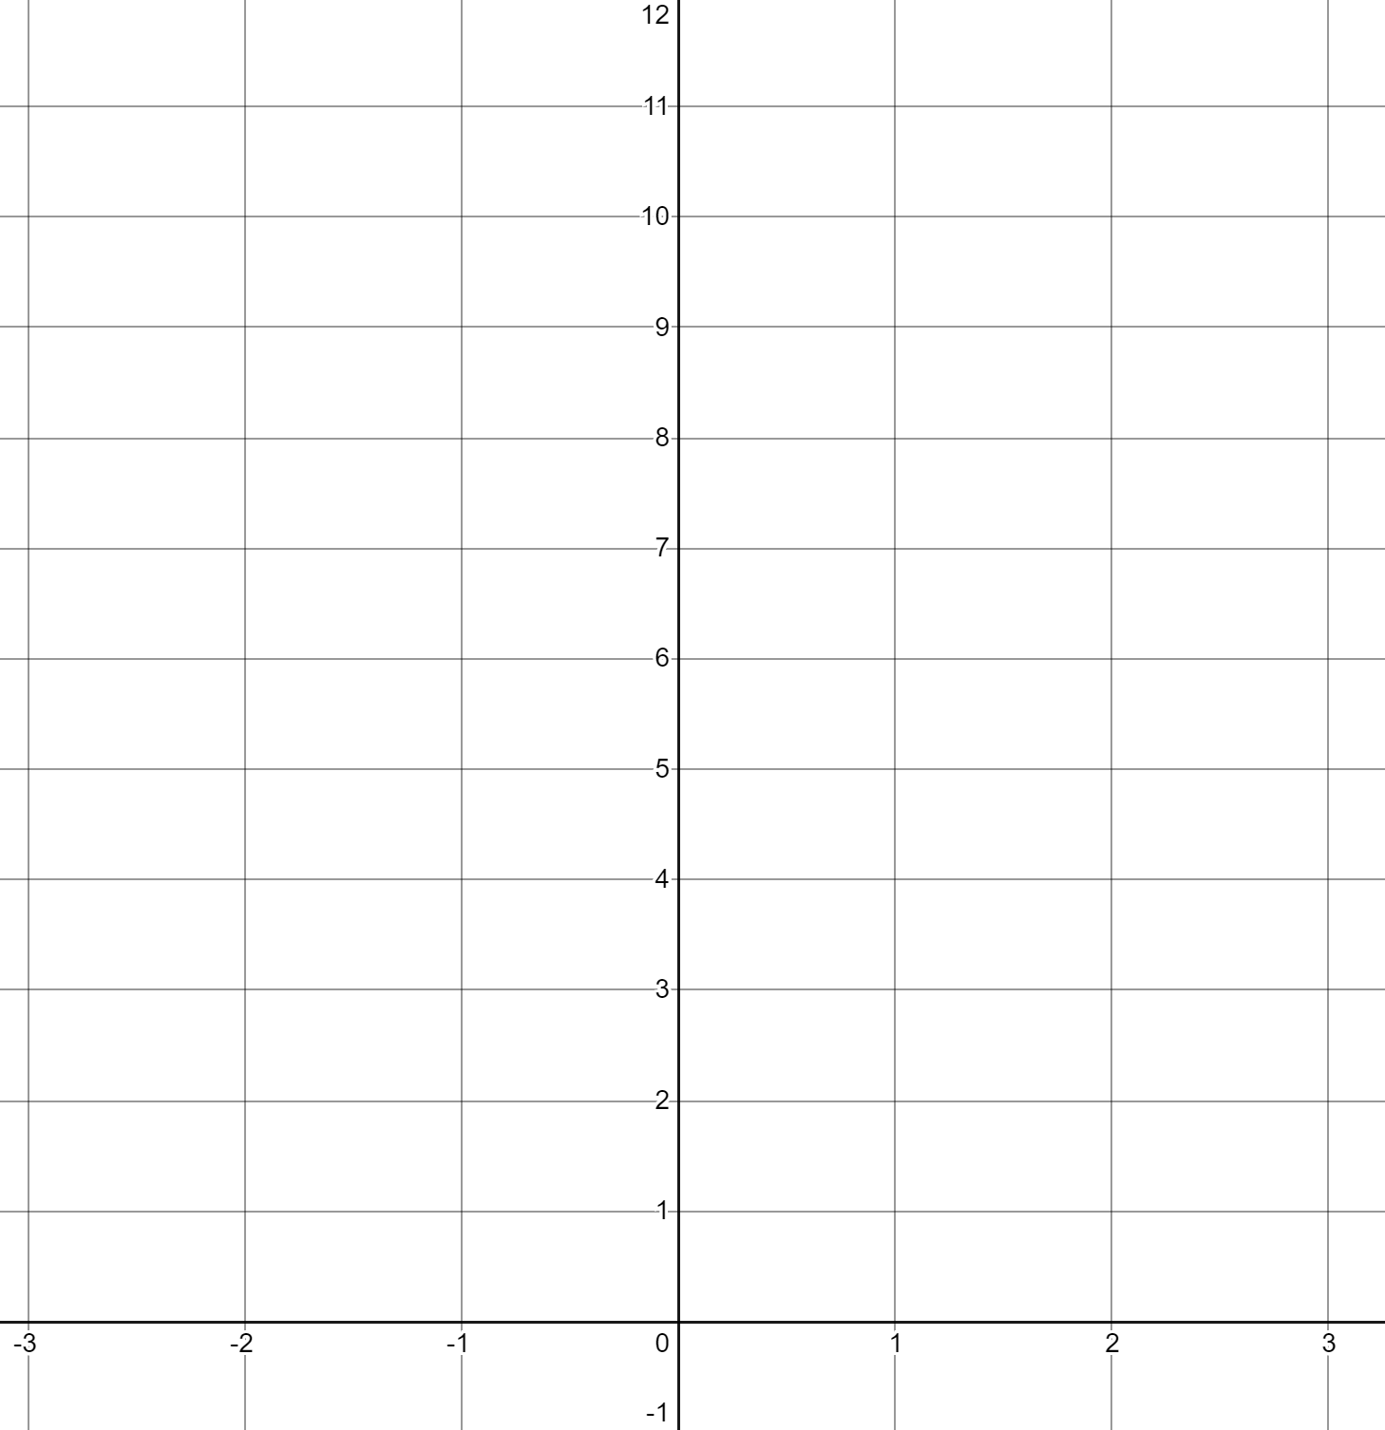
CFU 1
CFU 3
Is this a maximum or minimum turning point?
x | -3 | -2 | -1 | 0 | 1 | 2
y | 12 | 7 | 4 | 3 | 4 | 7
Where is the turning point?
CFU 2
This quadratic relationship has a:
Minimum TP at (0,3)
Line/axis of symmetry x = 0
x-int (no x-intercept)
y-int (0,3)
From the graph, find x when
y = 7: x = -2 , x = 2
At what x value is our line of symmetry?

Slide 4




Guided Practice
Daily Review
CFU 1
What did we do to find the value of y when x = -3?
Sketch the graph of the following equation $y=−x2+3$for $−3≤x≤2$
Substitute each number into the equation to find the points we need.
CFU 2
What did we do to find the value of y when x = -2?
$$y=−x^{2}+3$$
$$y =−{\left(−2\right)}^{2}+3$$
$$=− \left(4\right)+3$$
$$=−4+3$$
$$=−1$$
$$y=−x^{2}+3$$
$$y =−{\left(−3\right)}^{2}+3$$
$$=− \left(9\right)+3$$
$$=−9+3$$
$$=−6$$
$$y=−x^{2}+3$$
$$y =−{\left(−1\right)}^{2}+3$$
$$=− \left(1\right)+3$$
$$=−1+3$$
$$=2$$
x | -3 | -2 | -1 | 0 | 1 | 2
y | -6 | -1 | 2 | 3 | 2 | -1

Slide 5
CFU 1
CFU 3
x | -3 | -2 | -1 | 0 | 1 | 2
y | -6 | -1 | 2 | 3 | 2 | -1
Is this a maximum or minimum turning point?
Where is the turning point?
CFU 2
This quadratic relationship has a:
Maximum TP at (0,3)
Line/axis of symmetry x = 0
x-int (2 x-intercepts)
y-int (0,3)
At what x value is our line of symmetry?

Slide 6
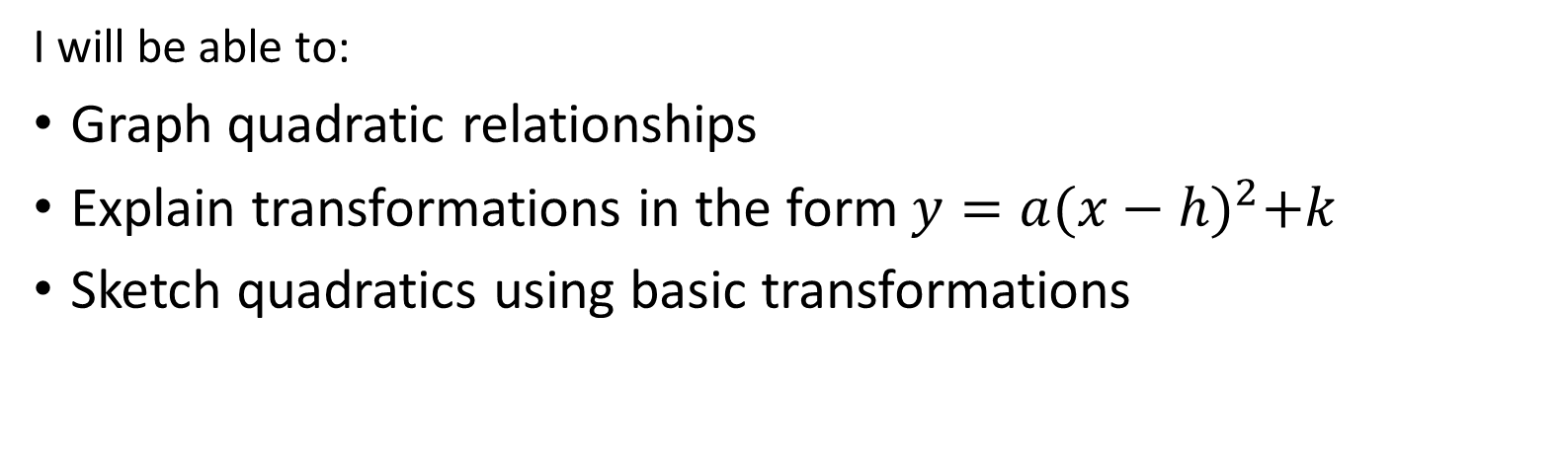
CFU 1
What will we learn today?
Today I will:
Graph a quadratic relationship
Explain simple transformations
Sketch quadratic equations from simple transformations
CFU 2
What will we learn today?
CFU 3
What will we learn today?
CFU 4
How will you know that you are successful?
I will be able to:
Graph quadratic relationships
Explain transformations in the form $y=a{(x−h)}^{2}+k$
Sketch quadratics using basic transformations
CFU 5
How will you know that you are successful?

Slide 7
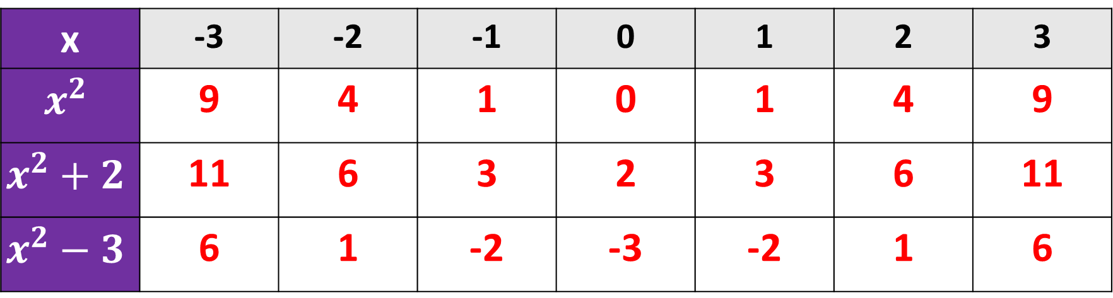

Concept Development
CFU 1
What did we do to find the value of y when x = -3?
Sketch the graph of the following equation $y = x2$, $y=x^{2}+2$ and $y=x^{2}−3$
for $−3≤x≤3$
Substitute each number into the equation to find the points we need.
CFU 2
What did we do to find the value of y when x = -2?
x | -3 | -2 | -1 | 0 | 1 | 2 | 3
$$x^{2}$$ | 9 | 4 | 1 | 0 | 1 | 4 | 9
$$x^{2}+2$$ | 11 | 6 | 3 | 2 | 3 | 6 | 11
$$x^{2}−3$$ | 6 | 1 | -2 | -3 | -2 | 1 | 6

Slide 8
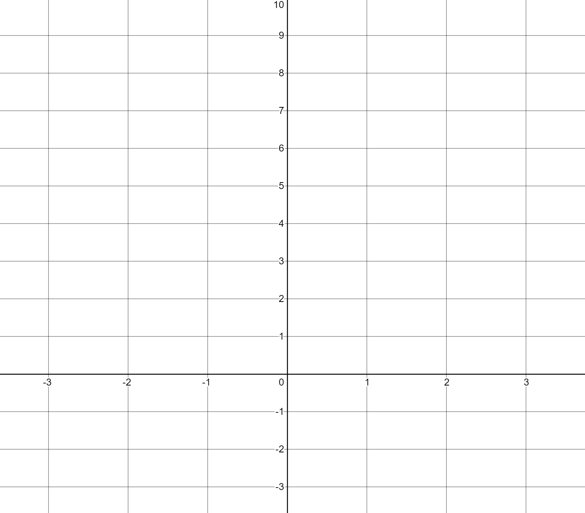
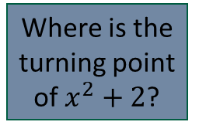
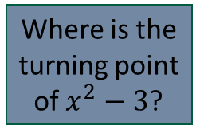
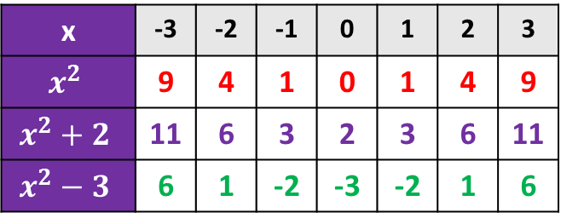
CFU 3
Where is the turning point of $x^{2}+2$?
CFU 3
Where is the turning point of $x^{2}−3$?
x | -3 | -2 | -1 | 0 | 1 | 2 | 3
$$x^{2}$$ | 9 | 4 | 1 | 0 | 1 | 4 | 9
$$x^{2}+2$$ | 11 | 6 | 3 | 2 | 3 | 6 | 11
$$x^{2}−3$$ | 6 | 1 | -2 | -3 | -2 | 1 | 6

Slide 9
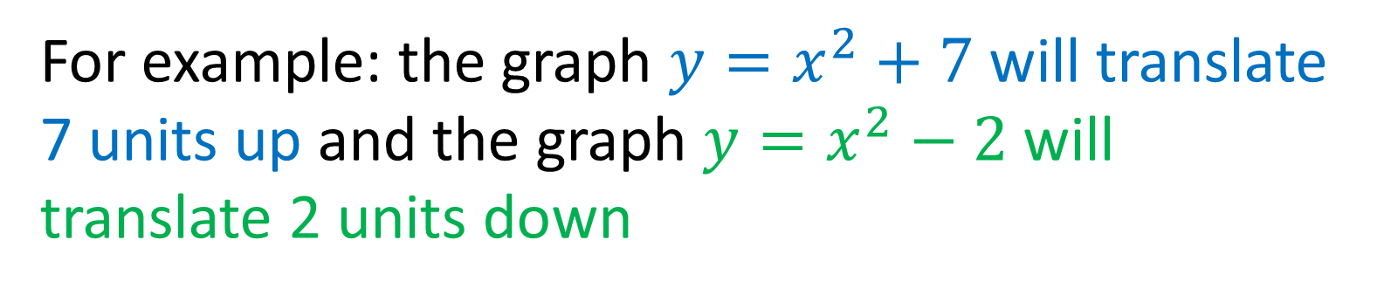
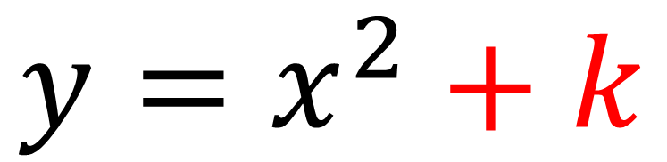
Skill Development
CFU 3
What is the effect of changing ‘k’?
$$y=x^{2}+k$$
CFU 3
What is the effect of changing the value of ‘k’?
What is the effect of changing ‘k’?
Vertical translation of the parabola ‘k’ units
For example: the graph $y=x^{2}+7$ will translate 7 units up and the graph $y=x^{2}−2$ will translate 2 units down

Slide 10
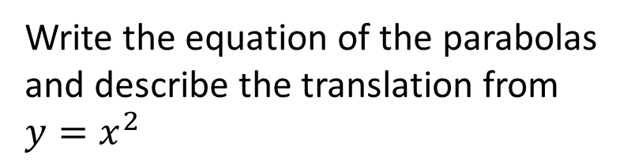



$$y=x^{2}$$
Write the equation of the parabolas and describe the translation from $y=x^{2}$
$$y=x^{2}+5$$
Vertical translation 5 units up
$$y=x^{2}−2$$
Vertical translation 2 units down

Slide 11
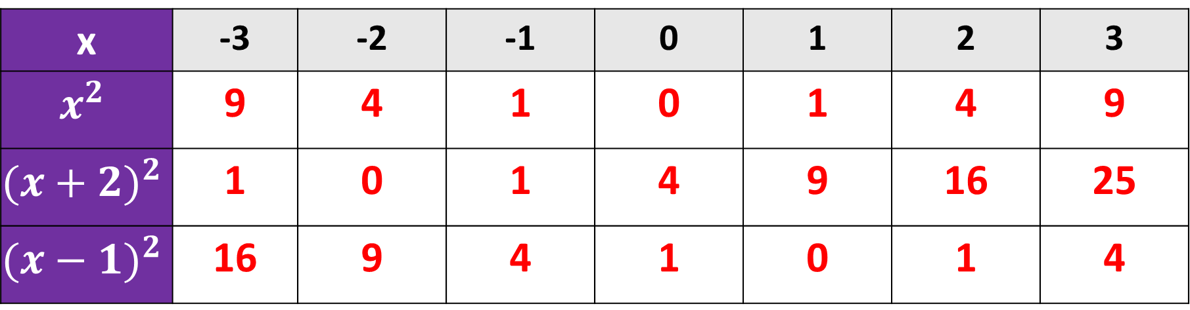

Concept Development
CFU 1
What did we do to find the value of y when x = -3?
Sketch the graph of the following equation $y = x2$, $y={(x+2)}^{2}$ and $y={(x−1)}^{2}$
for $−3≤x≤3$
Substitute each number into the equation to find the points we need.
CFU 2
What did we do to find the value of y when x = -2?
x | -3 | -2 | -1 | 0 | 1 | 2 | 3
$$x^{2}$$ | 9 | 4 | 1 | 0 | 1 | 4 | 9
$${(x+2)}^{2}$$ | 1 | 0 | 1 | 4 | 9 | 16 | 25
$${(x−1)}^{2}$$ | 16 | 9 | 4 | 1 | 0 | 1 | 4

Slide 12
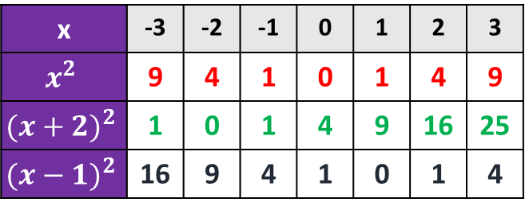
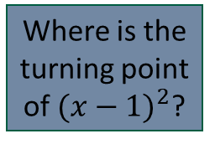
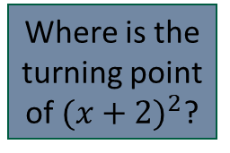
CFU 3
Where is the turning point of ${(x+2)}^{2}$?
CFU 3
Where is the turning point of ${(x−1)}^{2}$?
x | -3 | -2 | -1 | 0 | 1 | 2 | 3
$$x^{2}$$ | 9 | 4 | 1 | 0 | 1 | 4 | 9
$${(x+2)}^{2}$$ | 1 | 0 | 1 | 4 | 9 | 16 | 25
$${(x−1)}^{2}$$ | 16 | 9 | 4 | 1 | 0 | 1 | 4

Slide 13
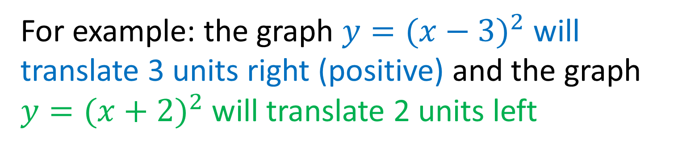
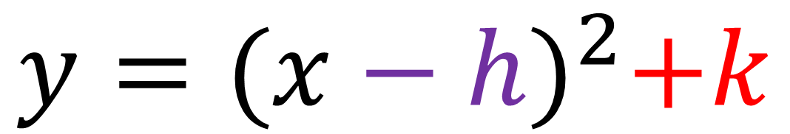
Skill Development
CFU 3
What is the effect of changing ‘h’?
$$y={(x−h)}^{2}+k$$
CFU 3
What is the effect of changing the value of ‘k’?
What is the effect of changing ‘h’?
Horizontal translation of the parabola ‘h’ units
(in an opposite direction)
For example: the graph $y={(x−3)}^{2}$ will translate 3 units right (positive) and the graph $y={(x+2)}^{2}$ will translate 2 units left

Slide 14


$$y=x^{2}$$
Write the equation of the parabolas and describe the translation from $y=x^{2}$
$$y={(x+1.5)}^{2}$$
Horizontal translation 1.5 units left
$$y={(x−1)}^{2}$$
Horizontal translation 1 units right

Slide 15
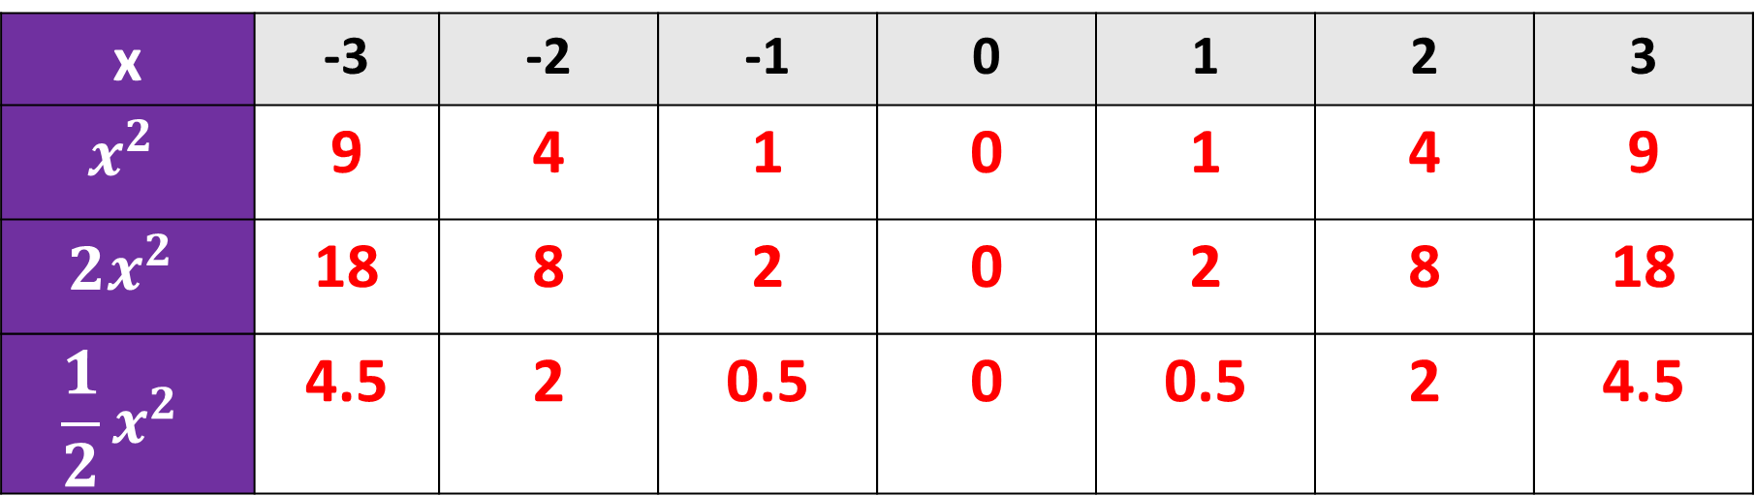

Concept Development
CFU 1
What did we do to find the value of y when x = -3?
Sketch the graph of the following equation $y = x2$, $y={2x}^{2}$ and $y={\frac{1}{2}x}^{2}$
for $−3≤x≤3$
Substitute each number into the equation to find the points we need.
CFU 2
What did we do to find the value of y when x = -2?
x | -3 | -2 | -1 | 0 | 1 | 2 | 3
$$x^{2}$$ | 9 | 4 | 1 | 0 | 1 | 4 | 9
$${2x}^{2}$$ | 18 | 8 | 2 | 0 | 2 | 8 | 18
$${\frac{1}{2}x}^{2}$$ | 4.5 | 2 | 0.5 | 0 | 0.5 | 2 | 4.5

Slide 16
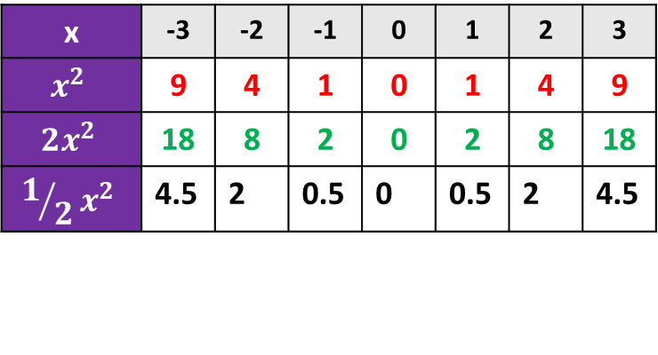
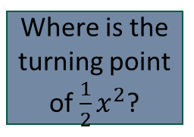
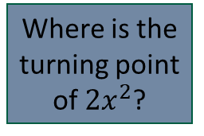
CFU 3
Where is the turning point of ${2x}^{2}$?
CFU 3
Where is the turning point of ${\frac{1}{2}x}^{2}$?
x | -3 | -2 | -1 | 0 | 1 | 2 | 3
$$x^{2}$$ | 9 | 4 | 1 | 0 | 1 | 4 | 9
$${2x}^{2}$$ | 18 | 8 | 2 | 0 | 2 | 8 | 18
$${1/2x}^{2}$$ | 4.5 | 2 | 0.5 | 0 | 0.5 | 2 | 4.5

Slide 17
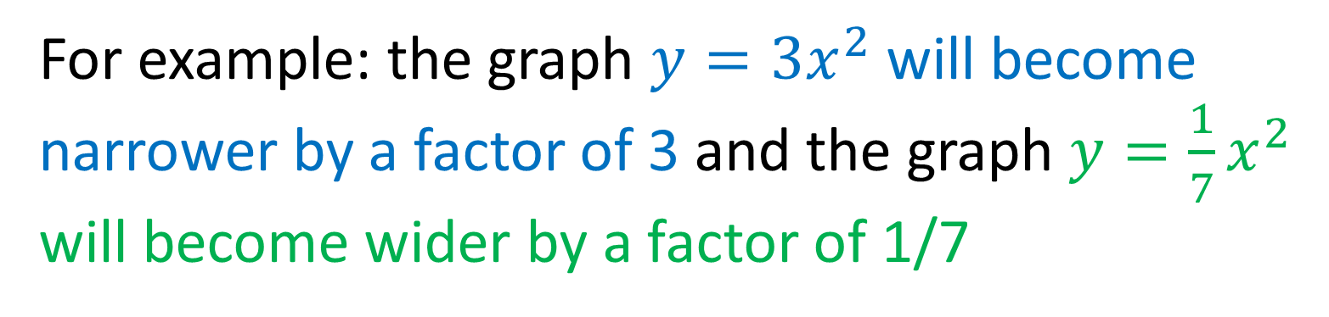
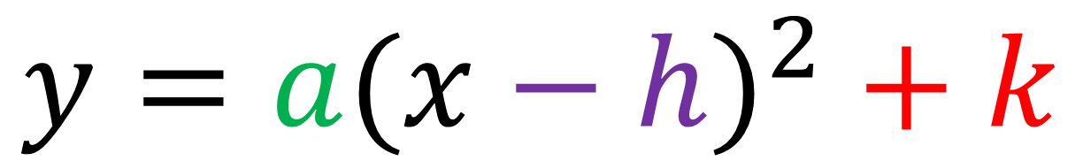
Skill Development
CFU 3
What is the effect of changing ‘a’?
$$y={a(x−h)}^{2}+k$$
CFU 3
What is the effect of changing the value of ‘a’?
What is the effect of changing ‘a’?
Dilation of the parabola by a factor of ‘a’ units making it narrower/wider
For example: the graph $y={3x}^{2}$ will become narrower by a factor of 3 and the graph $y={\frac{1}{7}x}^{2}$ will become wider by a factor of 1/7

Slide 18
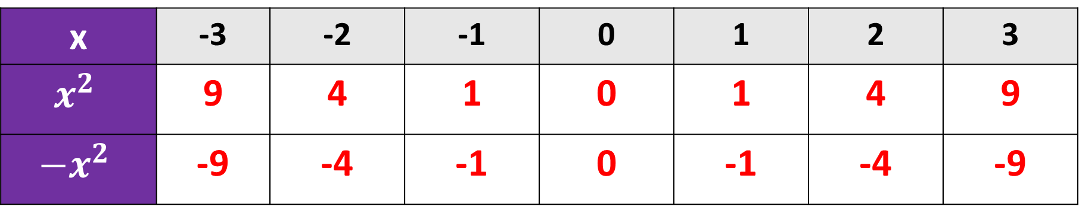

Concept Development
CFU 1
What did we do to find the value of y when x = -3?
Sketch the graph of the following equation $y = x2$, $y={−x}^{2}$ for $−3≤x≤3$
Substitute each number into the equation to find the points we need.
CFU 2
What did we do to find the value of y when x = -2?
x | -3 | -2 | -1 | 0 | 1 | 2 | 3
$$x^{2}$$ | 9 | 4 | 1 | 0 | 1 | 4 | 9
$${−x}^{2}$$ | -9 | -4 | -1 | 0 | -1 | -4 | -9

Slide 19
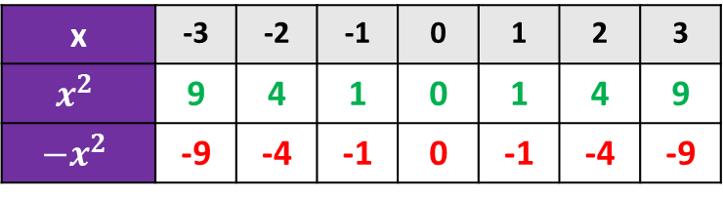
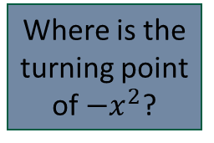
CFU 3
Where is the turning point of ${−x}^{2}$?
x | -3 | -2 | -1 | 0 | 1 | 2 | 3
$$x^{2}$$ | 9 | 4 | 1 | 0 | 1 | 4 | 9
$${−x}^{2}$$ | -9 | -4 | -1 | 0 | -1 | -4 | -9

Slide 20
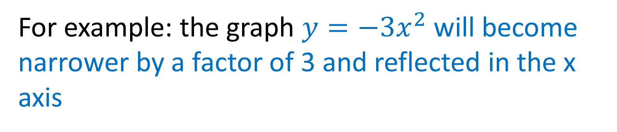
Skill Development
CFU 3
$$y={a(x−h)}^{2}+k$$
What is the effect of changing ‘a’ to a negative?
What is the effect of ‘a’ becoming negative?
Reflects the parabola in the x axis
For example: the graph $y={−3x}^{2}$ will become narrower by a factor of 3 and reflected in the x axis

Slide 21
Skill Development
CFU 3
$$y={a(x−h)}^{2}+k$$
What is the effect of changing ‘k’?
What are the effects of changing the value of ‘k’, ‘h’ and ‘a’?
CFU 3
k – Vertical Translation
What is the effect of changing ‘h’?
h – Horizontal Translation (opposite direction)
a – dilation of parabola (wider or narrower)
a – negative value reflects in the x axis

Slide 22
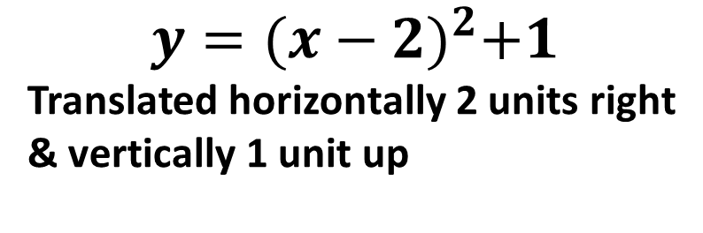
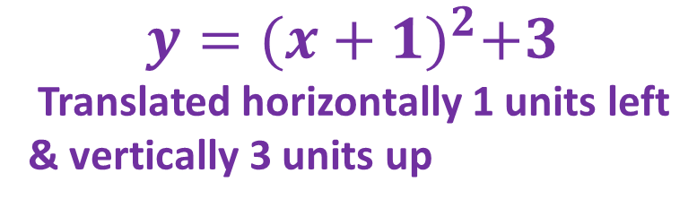
$$y=x^{2}$$
Write the equation of the parabolas and describe the translation from $y=x^{2}$
$$y={(x+1)}^{2}+3$$
Translated horizontally 1 units left
& vertically 3 units up
$$y={(x−2)}^{2}+1$$
Translated horizontally 2 units right
& vertically 1 unit up

Slide 23
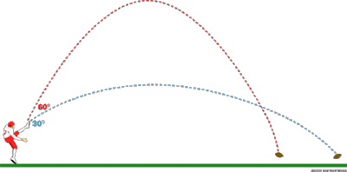
Independent Practice
Pearson 10 Mathematics
Exercise 4.4 Questions 4, 6(b) and 10

